Slide 1


Welcome to FINTECH: What and How to Embrace It event by IndonesiaX Monday, February 27, 2017 Supported by:

Slide 2


MAC’s Background
MAC offers the “City Athletic Club” concept, which is the first of its kind in Jakarta. It combines business, social and athletic opportunities in one single convenient location. It is located in the heart of Jakarta’s central business district at the World Trade Center on JL. Jenderal Sudirman to provide easy access for its members.

Slide 3
NOW
We Have 104 Reciprocal Clubs Around The World

Slide 4
Indonesia Surabaya: Ciputra Golf, Club & Hotel

Slide 5
ASIA
HONGKONG
Butterfields
Kowloon Cricket Club
World Trade Centre Club
The Foreign Correspondent’s Club
The Country Club
Discovery Bay Recreation Club
The Dynasty Club
CHINA
YongFoo Elite
Imperial Palace
Ambassy Club Shanghai
The Shanxi Capital Club
Capital club Chang An Club
THAILAND
The British Club Bangkok
Pacific City Club
THE PHILLIPINES Manila Boat Clubines VIETNAM Sedona Town Club CAMBODIA The Vault Club
MALAYSIA
The Penang Club
Royal Port Dickson Yacht
Club
Royal Selangor Club
JAPAN
Tokyo American Club
SINGAPORE
Aranda Country Club
The American Club
Singapore Polo Club
The British Club
Singapore Cricket Club
Raffles Marina
One 15 Marina Club
INDIA
- Citi Club
The Palms Town &
Country Club
- The Koramangala Club

Slide 6
AUSTRALIA
Oslo, Norway Shippingklubben Amsterdam, Netherlands De Koninklijke Industrieele Groote Club The Hague, Netherlands Nieuwe of Litteraire Societeit De Witte Lisbon, Portugal Belas Clube De Campo
The Western Australian Club
Tattersalls’s Club
The Launceston Club Inc.
United Service Club
City Tattersalls Club
Tattersalls Club
The NewCastle Club
Kooyong Lawn Tennis Club Inc.
UNITED KINGDOM
ST. James’s Hotel & Club
The Landsdowne Club
Oriental Club
National Liberal Club
Bath & Country Club
The Royal Scots Club
Paris, France Saint James Paris Luxembourg, Luxembourg Cercle Munster Bilbao, Spain Sociedad Bilbaina

Slide 7
USA
Tallahassee, Florida
Governors Club
Orlando, Florida
The University Club of Orlando
Chicago, IL
The Buckingham Athletic Club
Oakland, CA
The Bellevue Club
Iowa, USA
The Des Moines Embassy Club
Embassy Club West
Honolulu, USA
The Plaza Club
Milwaukee, USA
The Woman’s Club Of Wisconsin
Oxnard USA
Tower Club
Houston, USA
Petroleum Club
Denver, USA
The Denver Athletic Club
Washington DC, USA
Capitol Hill Club
New Haven, USA
The Q Club The Graduate Club
New London, USA
The Thames Club
Madison Wi, USA
Madison Club
Atlanta, USA
The Georgian Club
California, USA
The University Club of St. Paul
Santa Barbara Club
New York, USA
The Penn Club
New York, USA
Genesse Valley Club
New York, USA
The Princeton Club of New York
New York, USA
The Columbia University Club of New York
The Williams Club of New York
The Buffalo Club
CANADA
Vancouver, Canada The Vancouver Club Hollyburn Country Club Terminal City Club Toronto, Canada The National Club The University Club Calgary, Canada The Glencoe Club
Ontario, Canada The London Club Ltd. Montreal, Canada Club Saint James Montreal Toronto, Canada The Boulevard Club

Slide 8
Bahrain, Kingdom of Bahrain Capital club of Bahrain Dubai, U. A. E Capital Club Dubai Istanbul, Turkey Buyuk Kulup (Cercle D’Orient) Santiago, Chile Club De Vina Del Mar Johannesburg, South Africa Rand Club Kenya, East Africa Capital Club East Africa

Slide 9
ANNUAL MEMBERSHIP PROMO Special Joining Fee at Rp. 25.000.000,- Nett (*Normal Annual Membership fee at Rp. 30.000.000 +10%VAT)
Term & Conditions :
Annual Membership includes joining fee and monthly dues for one year
Annual Membership is non Transferable, and non Refundable
Membership includes full spouse privileges, and Children of member below 21 years old are welcome to the Club on Weekend & School Holiday only
Special Annual Membership program is valid from November – December 2016.
Club Benefits:
Enjoying Reciprocal Club privileges in 103 Clubs Worldwide.
Enjoying Reciprocal Golf Course & Country Club privileges in Indonesia:
(Rainbow Hills, Emeralda Golf Club, Palm Hill Golf, Sentul Highlands, 5.Bogor Raya Golf, Nirwana Bali Golf).
Enjoying the Sport facilities at the Club to pursue your Hobby.
Free to use the Function rooms at the Club to for your company needs.
Club Rewards:
Get Complimentary MAC’s Merchandise.
Get one time Complimentary Dinning at MAC Restaurants for the New Members only.
For more details information, please contact Membership Department at 021-5211320
(Ms. Fitri / Ms. Anti / Ms. Olivia).

Slide 10
MAC Facilities

Slide 11
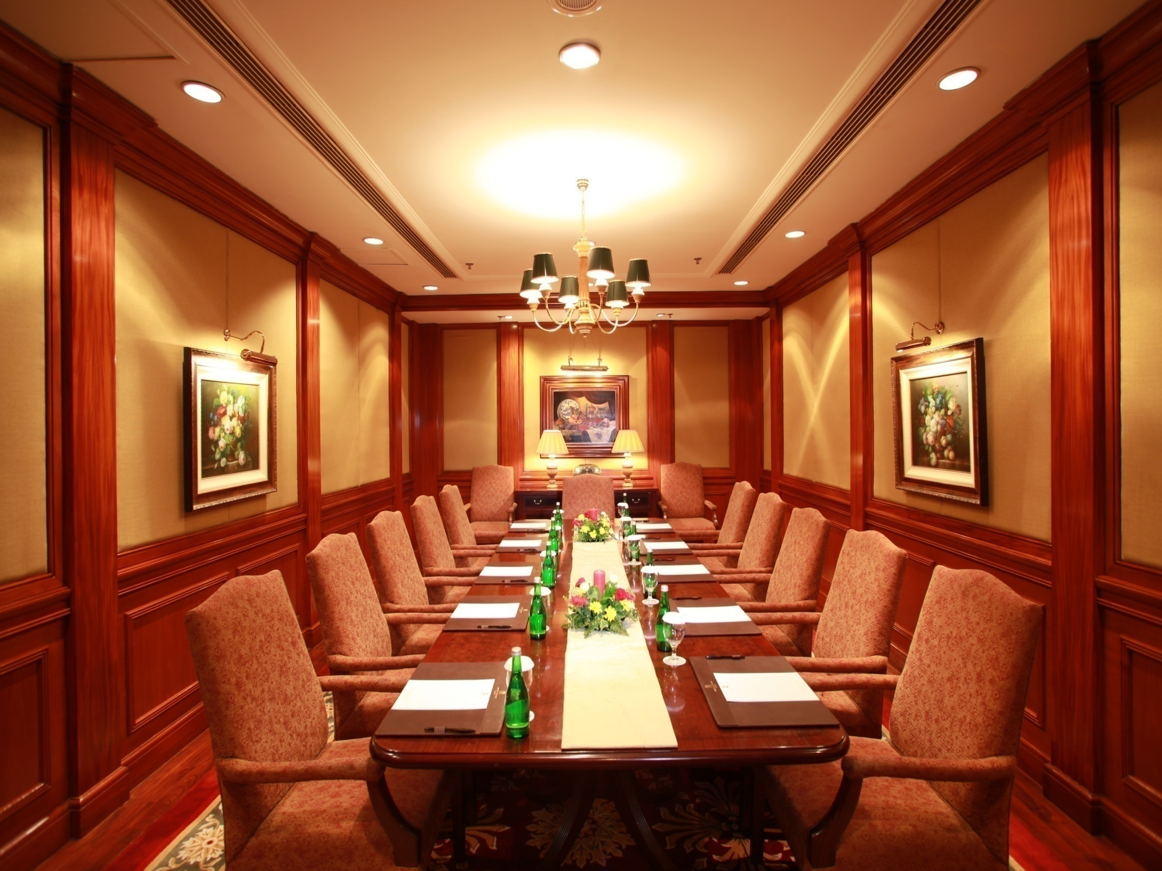
Boardroom

Slide 12
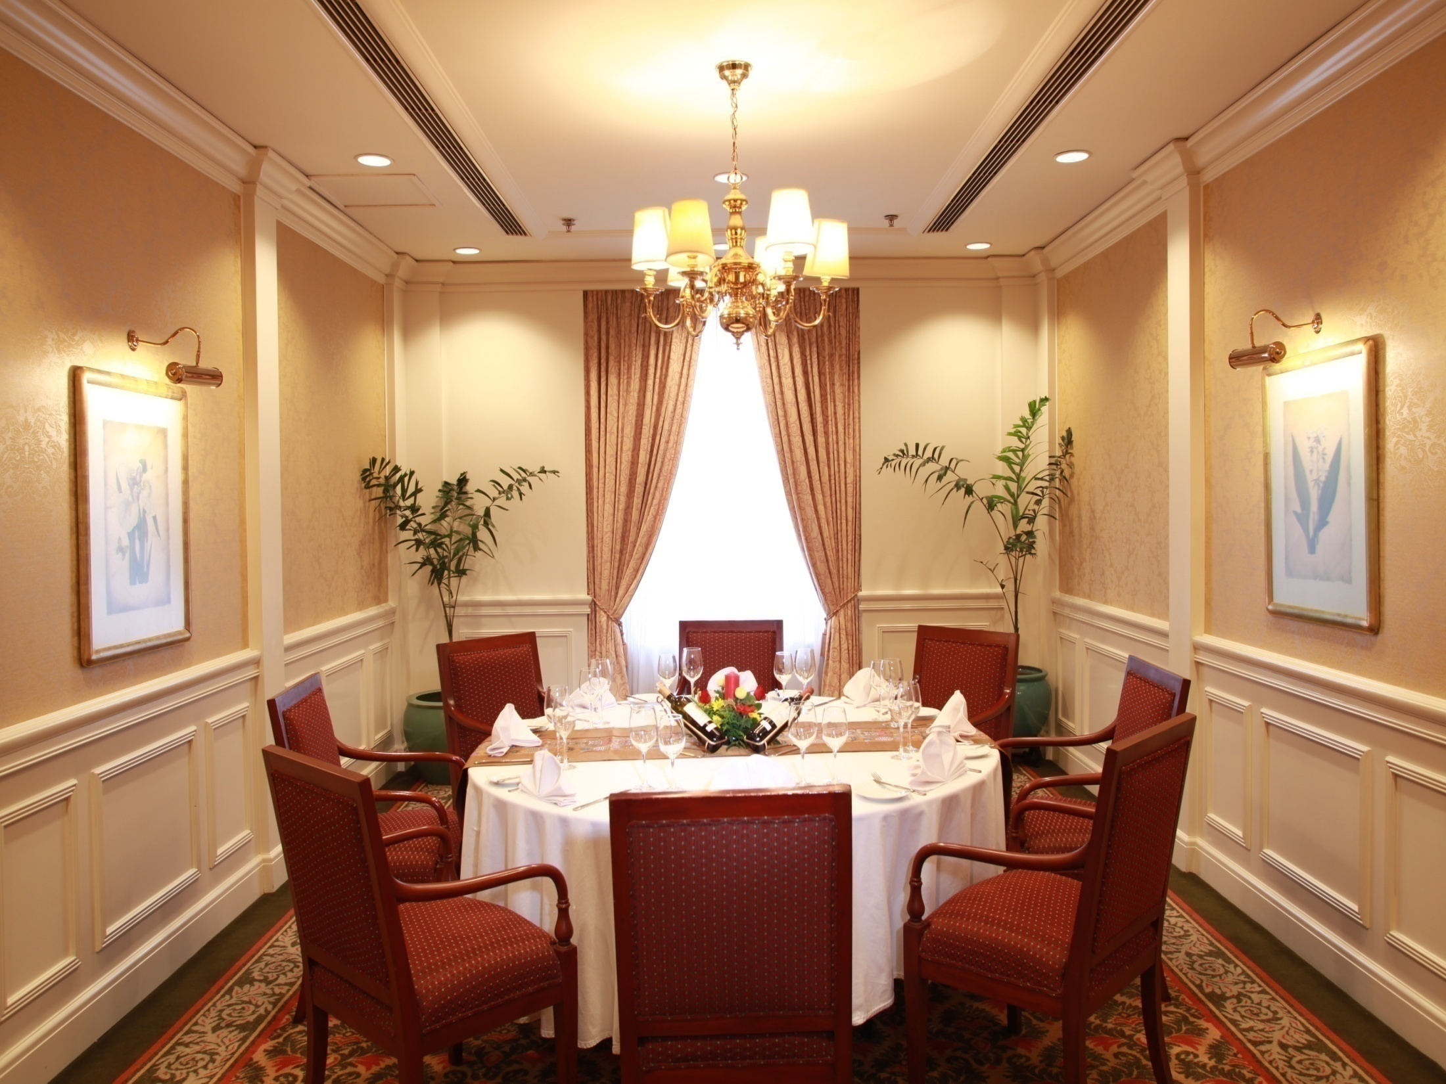
Malintang Room

Slide 13
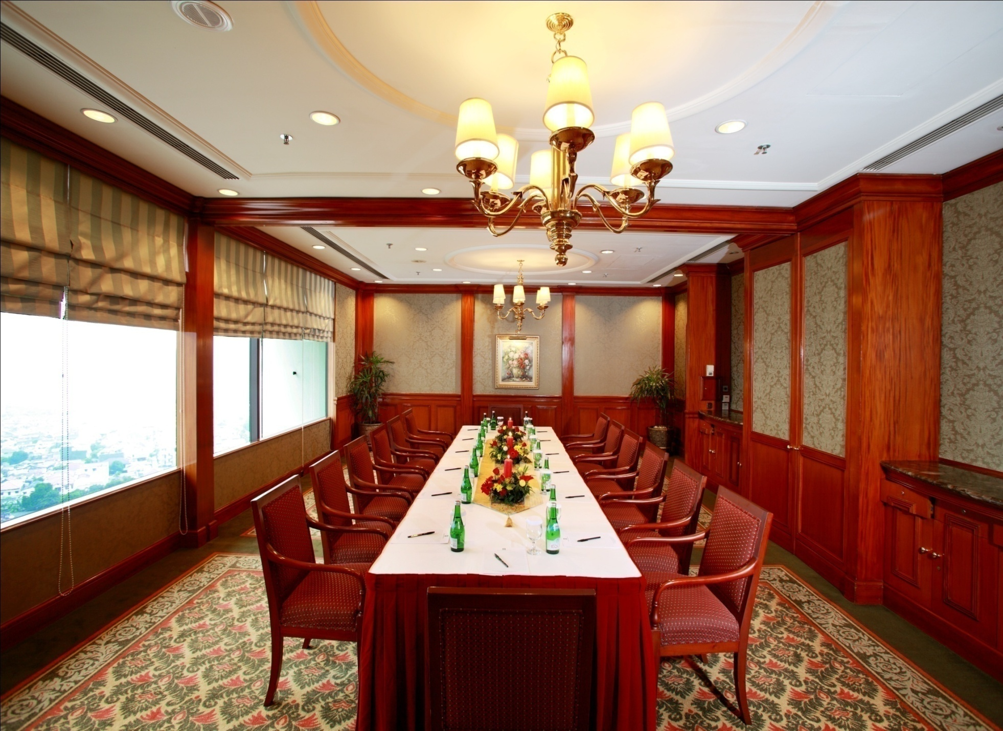
Balease & Arjuno Room

Slide 14
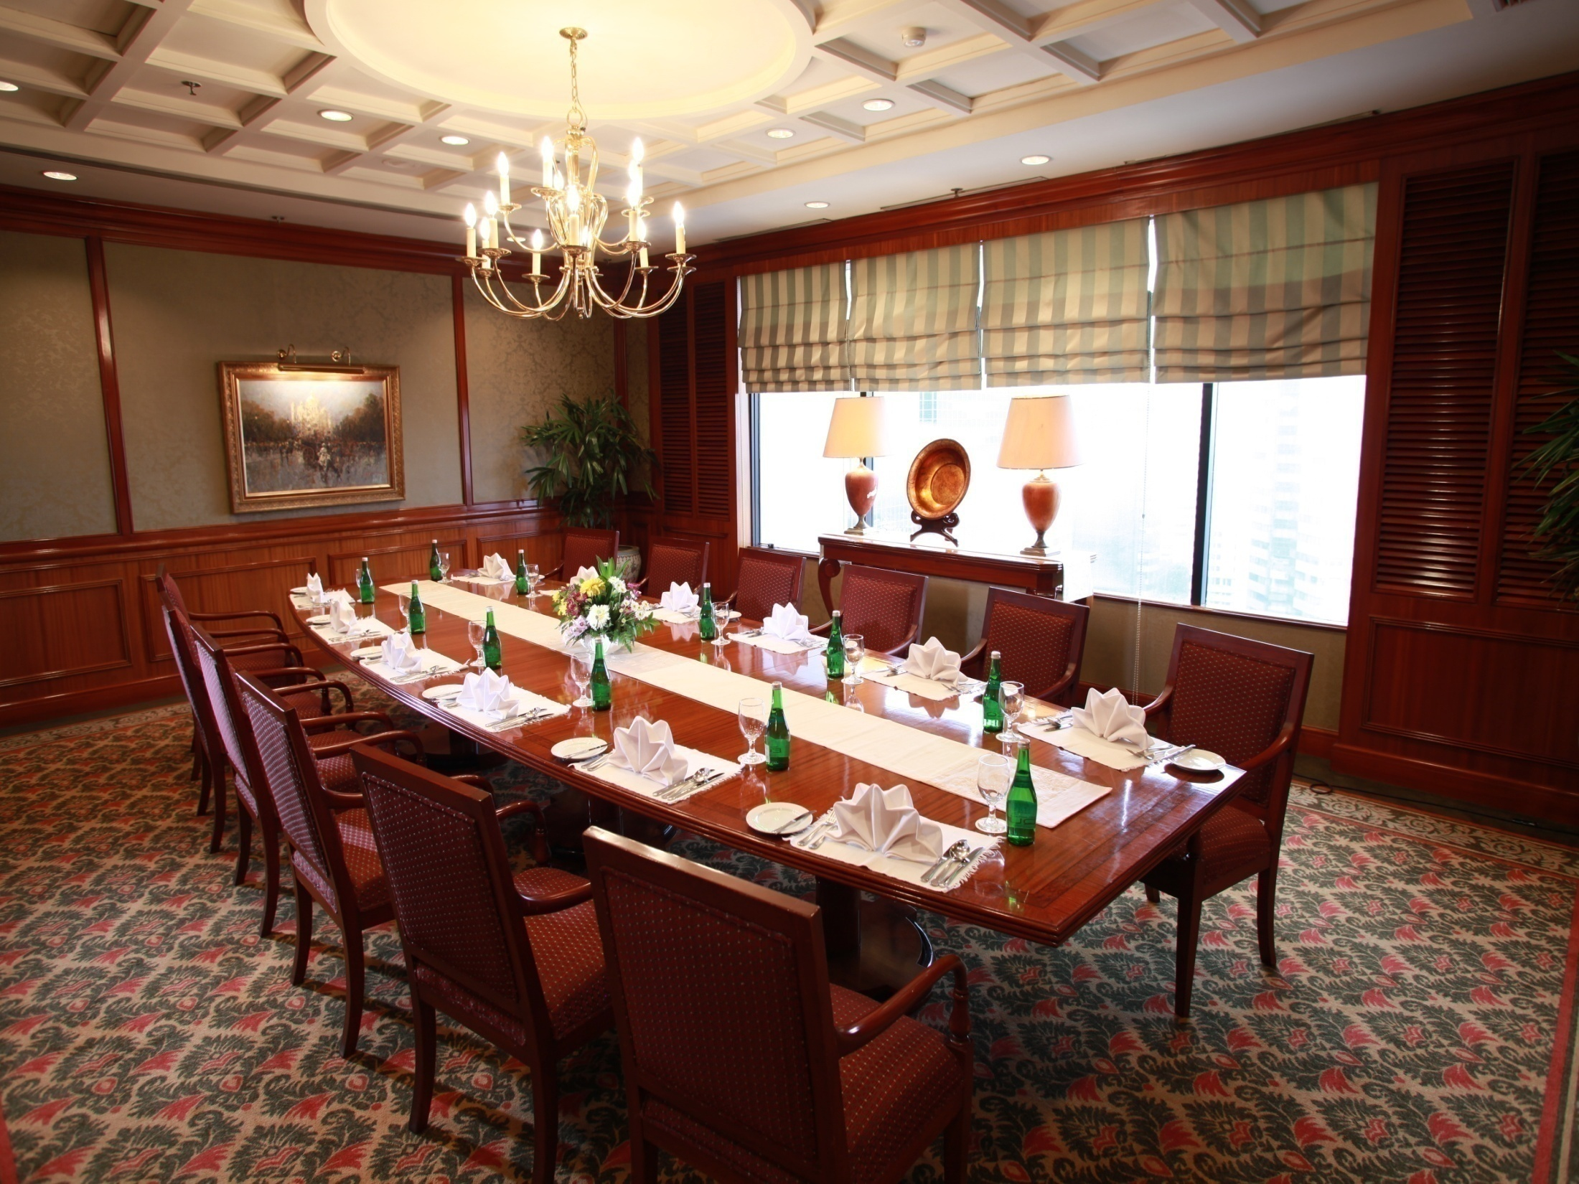
Annexe 1

Slide 15
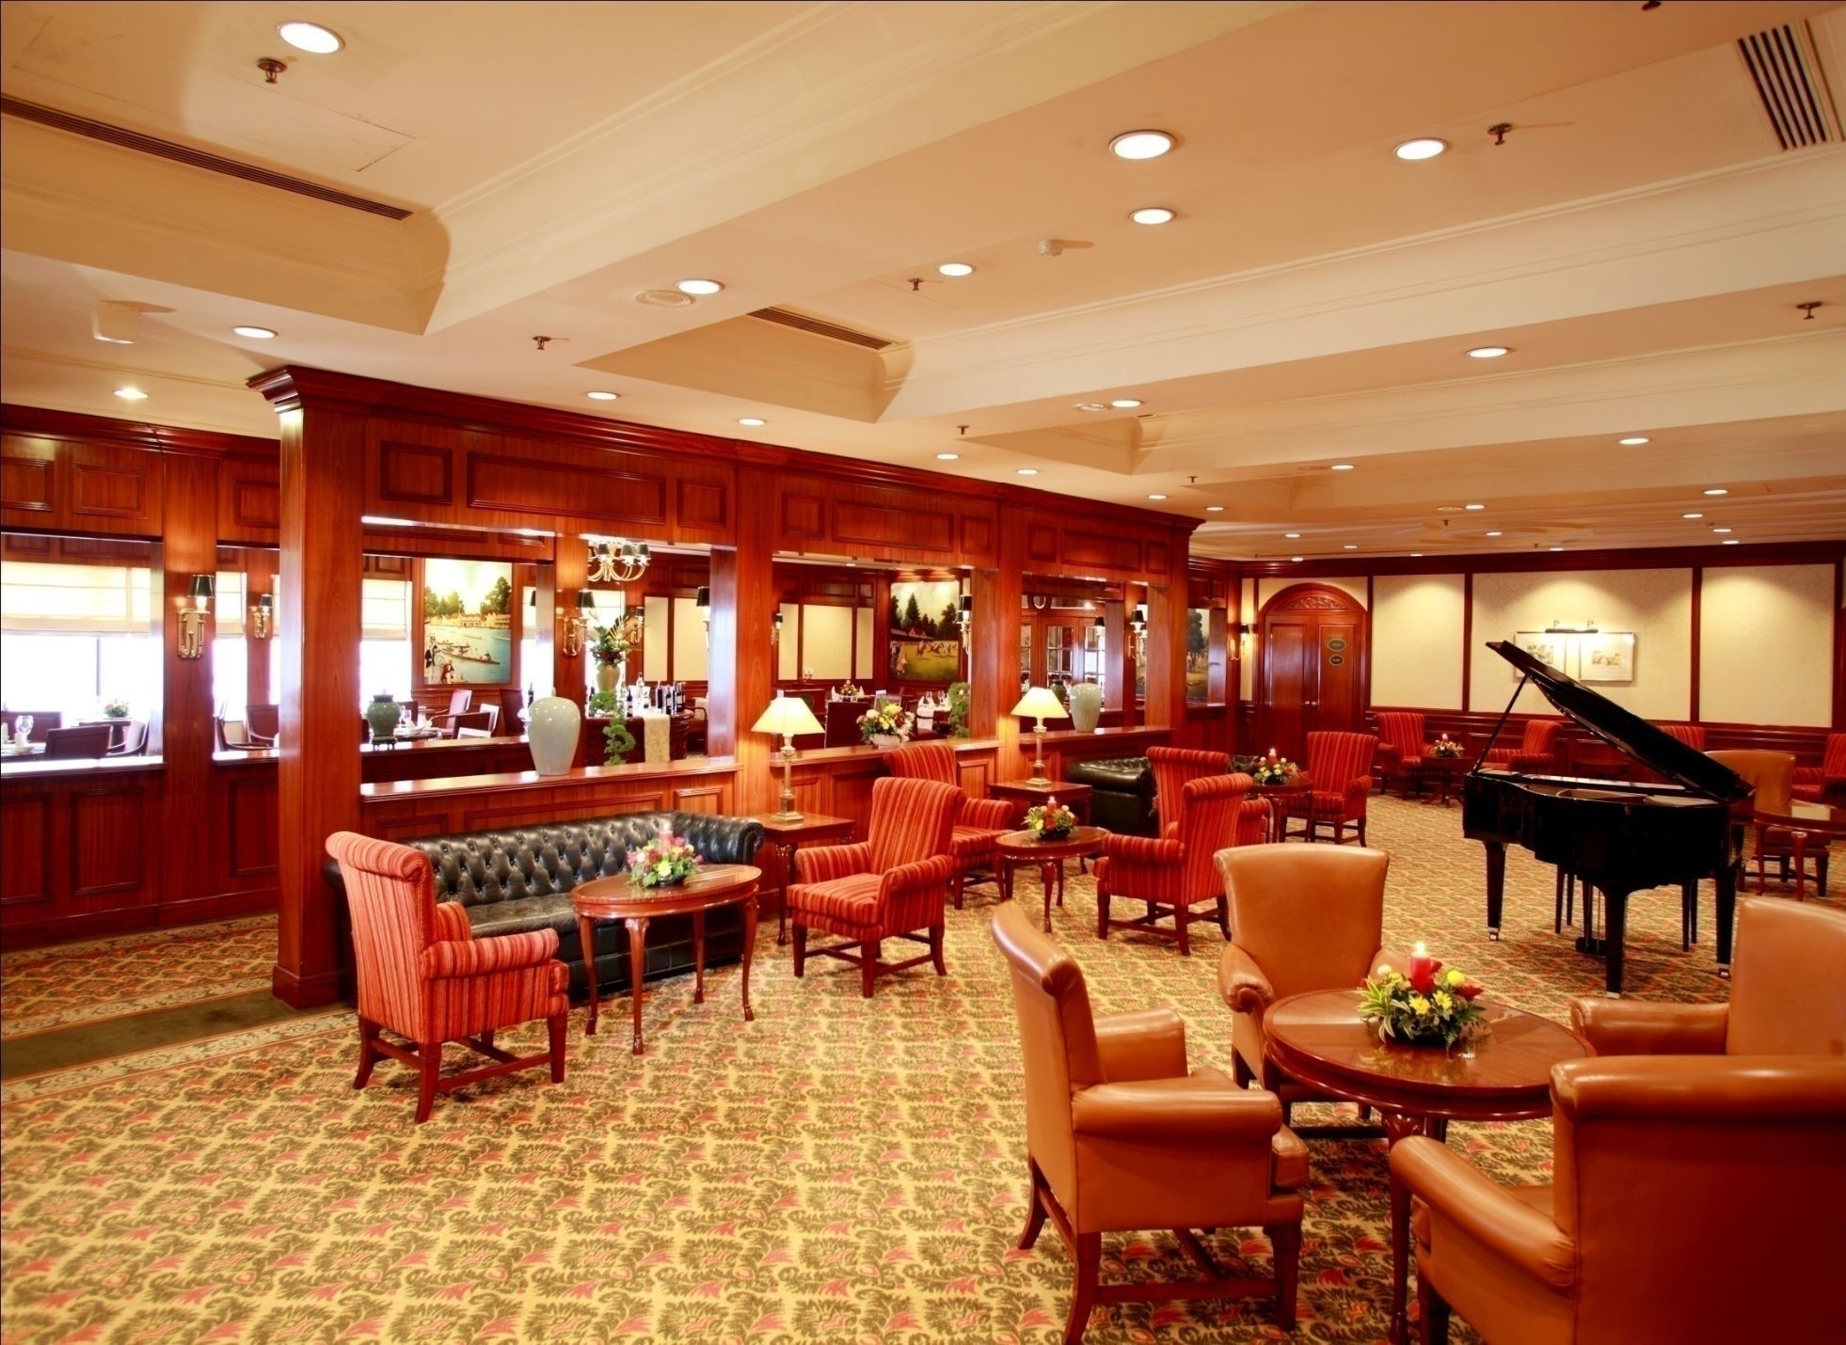
Lounge

Slide 16
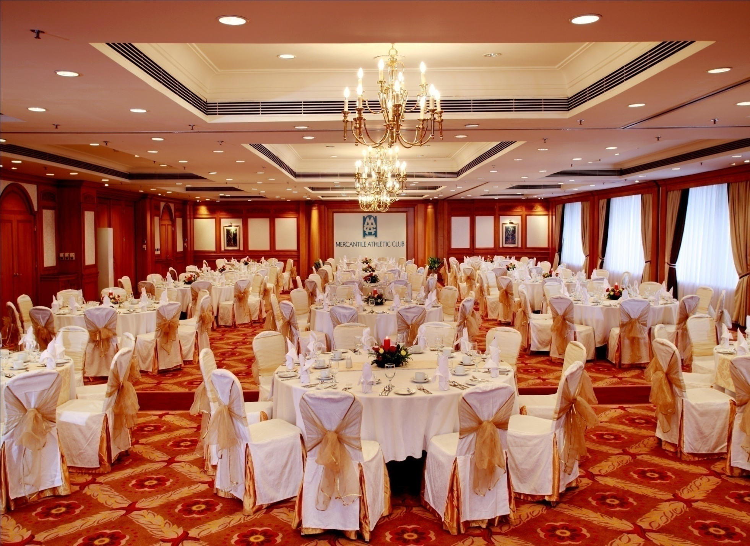
Ballroom

Slide 17
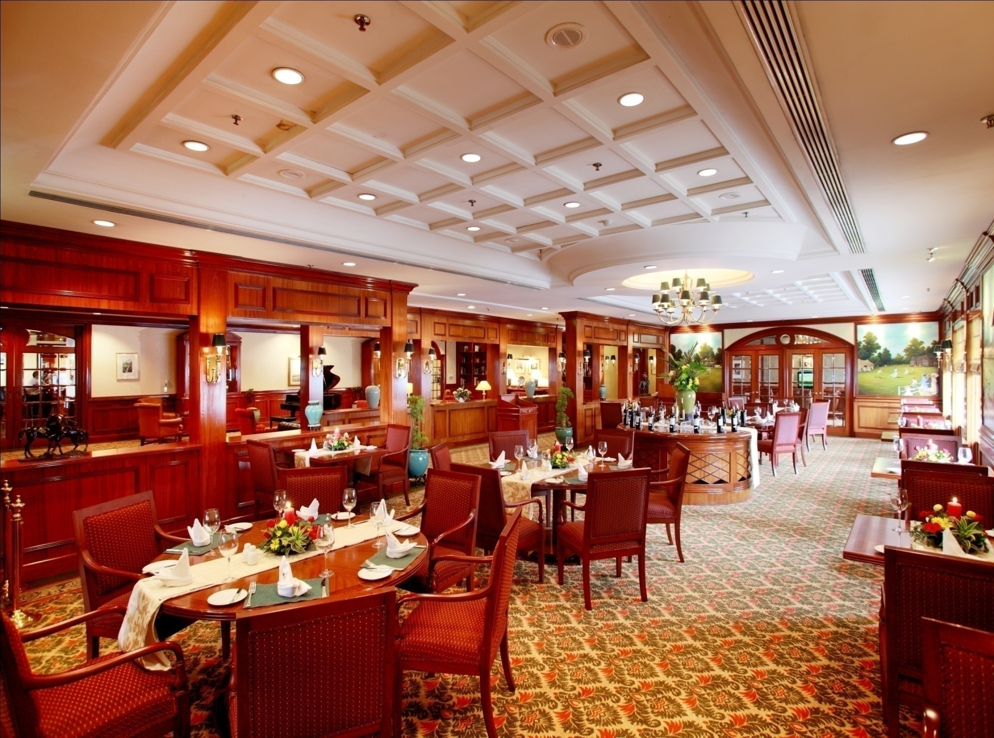
Wimbledon Grill

Slide 18
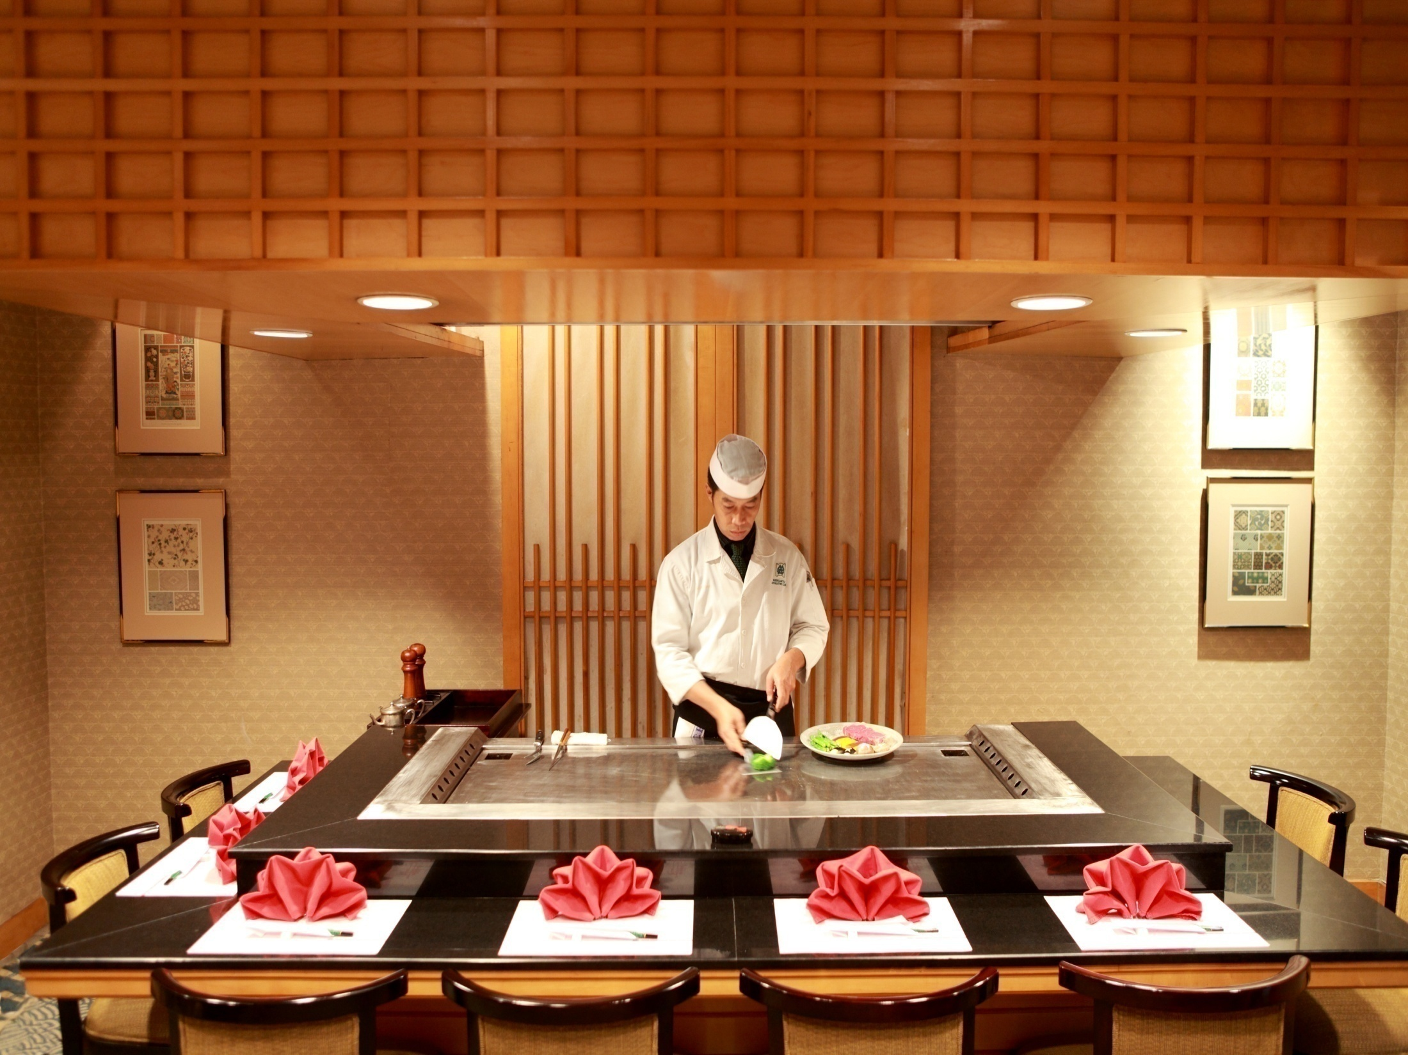
Miyabi Japanese

Slide 19
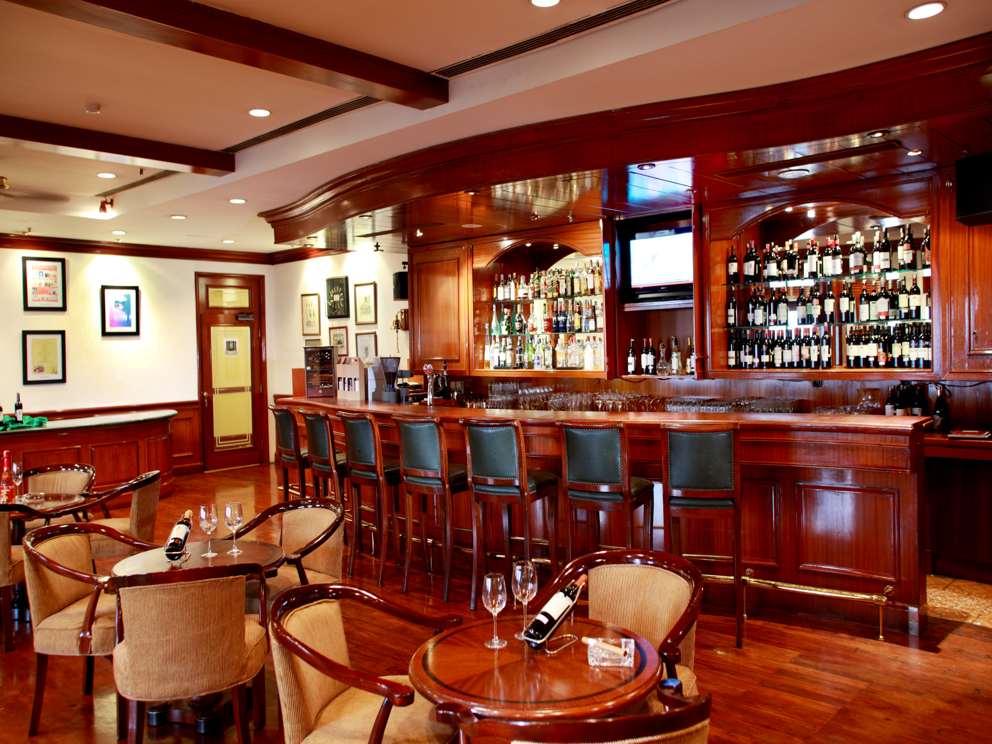
Shutters Bar

Slide 20
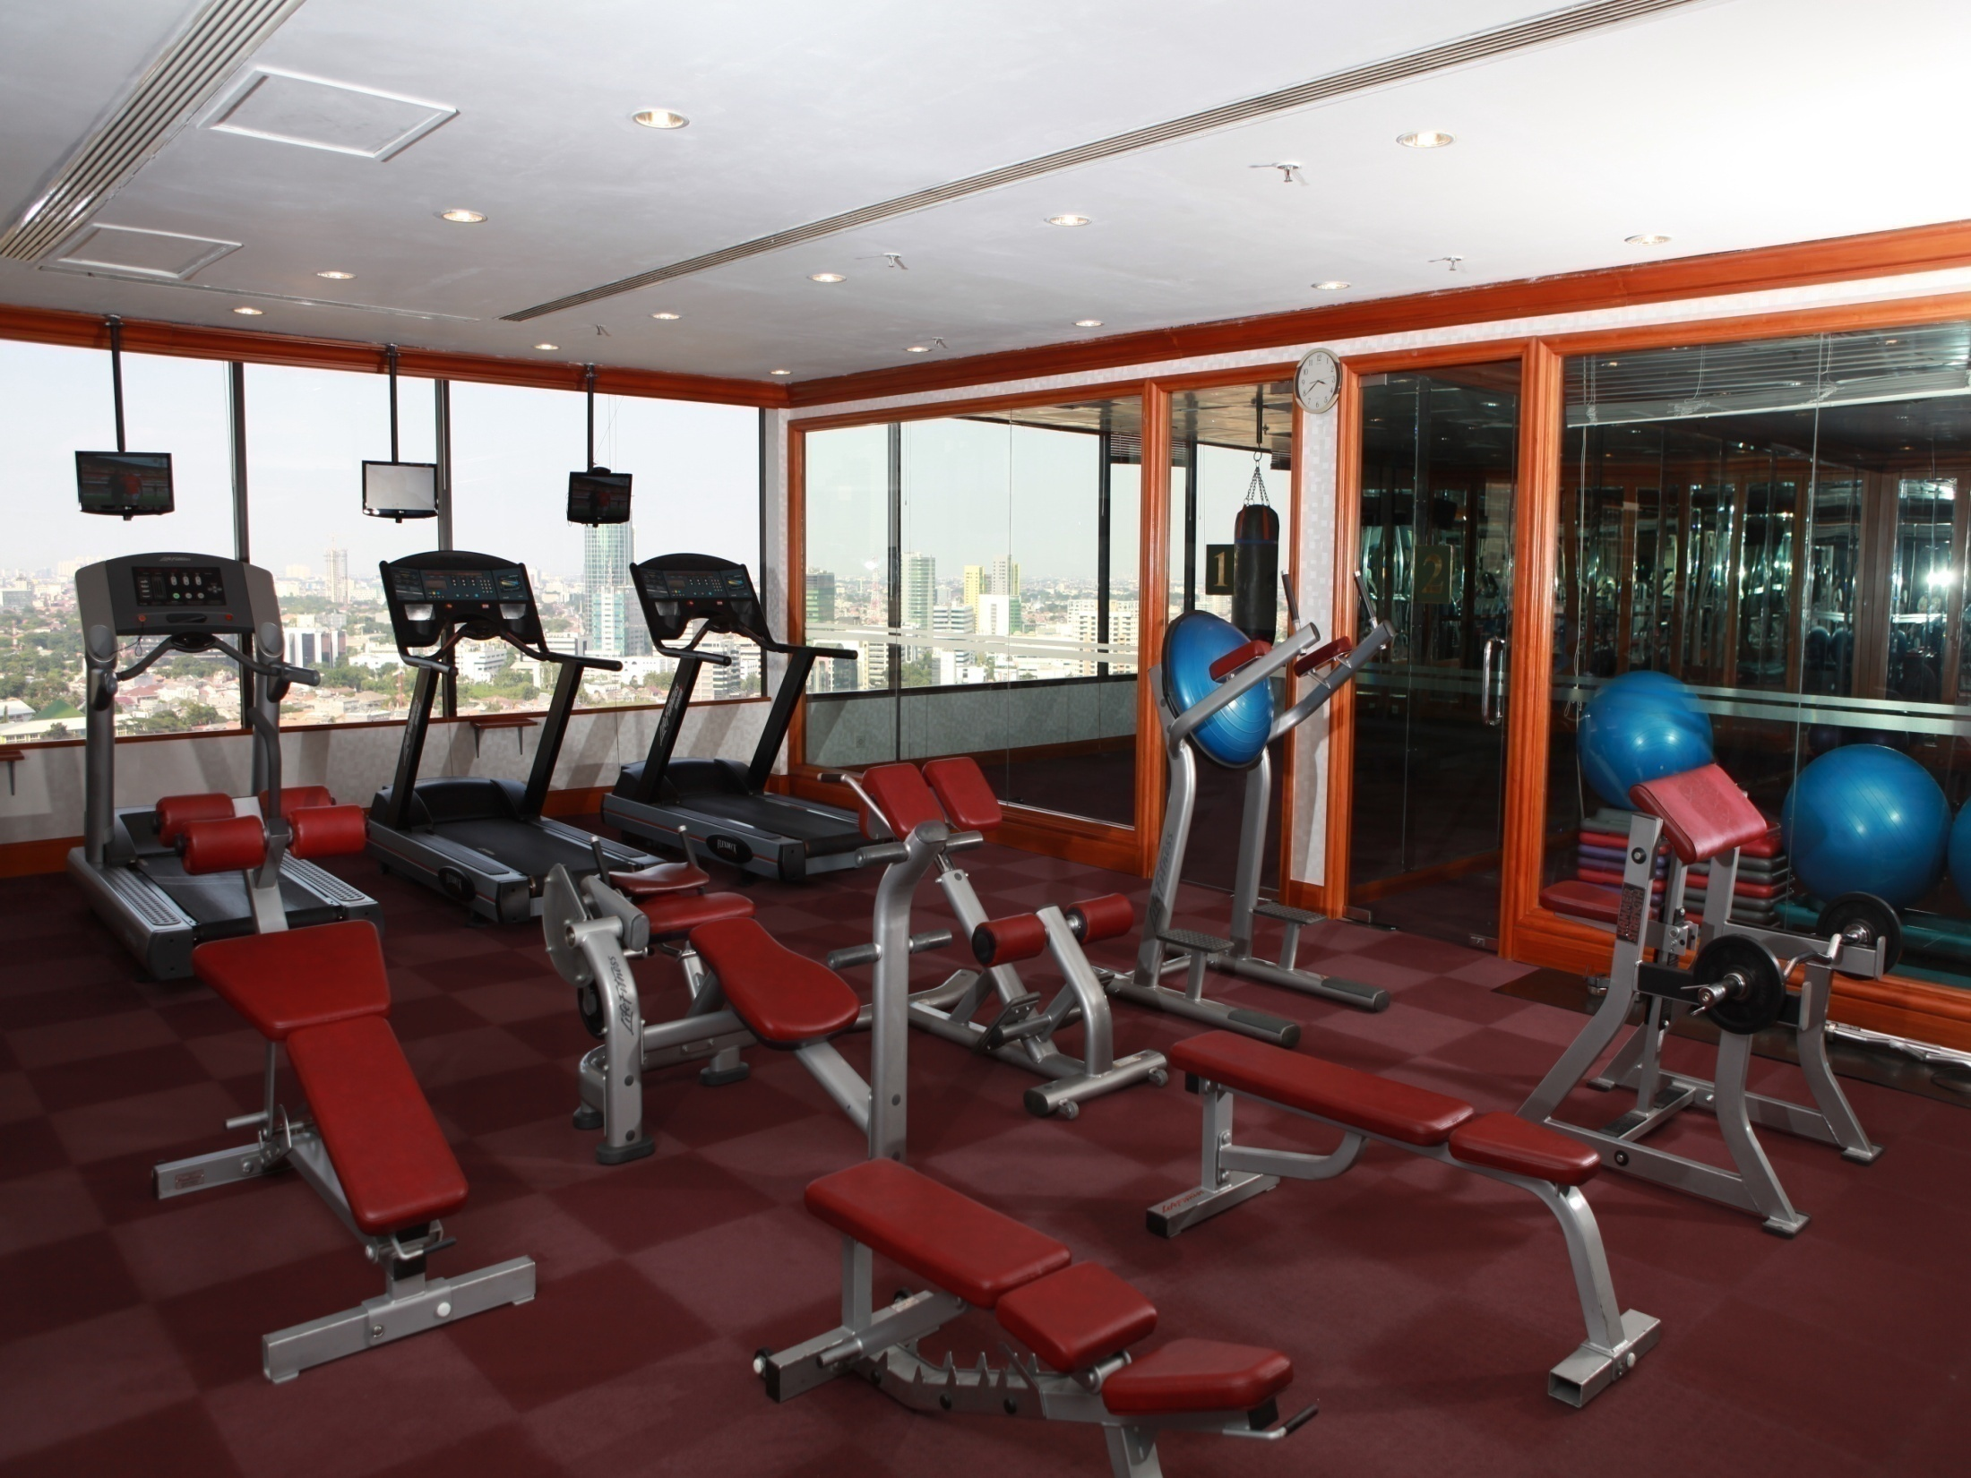
Gym Room

Slide 21
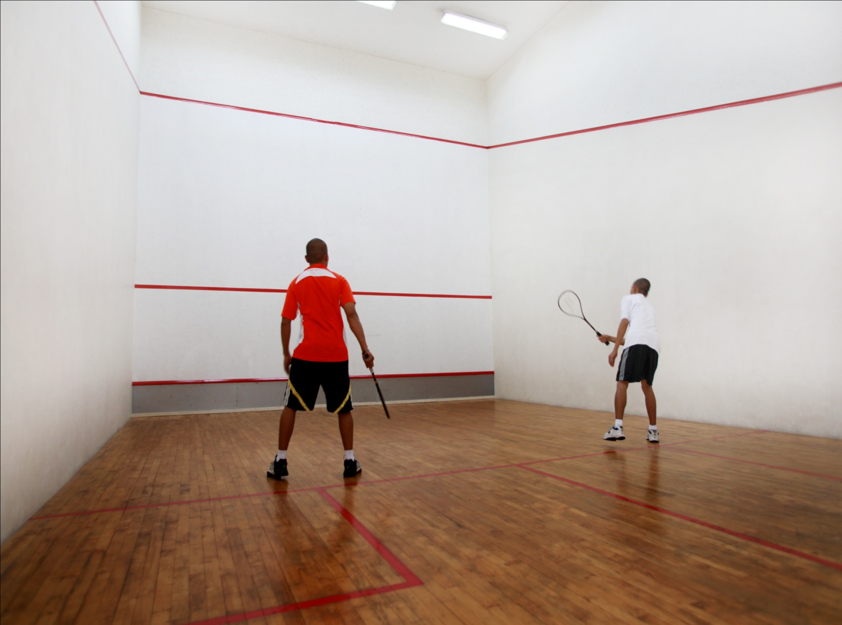
Squash Court

Slide 22
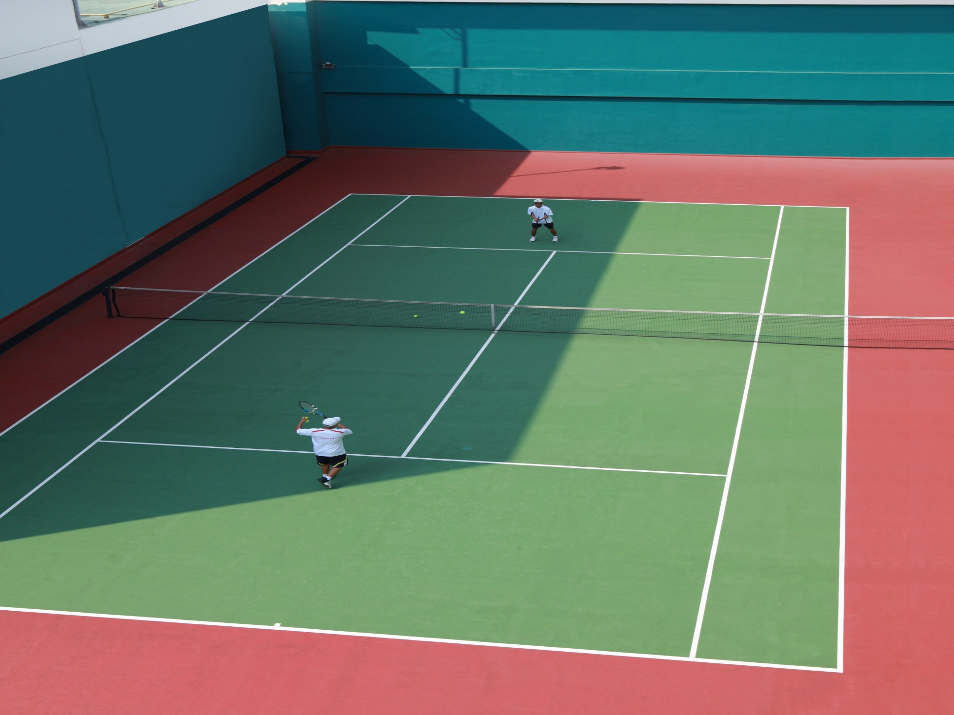
Tennis Court

Slide 23
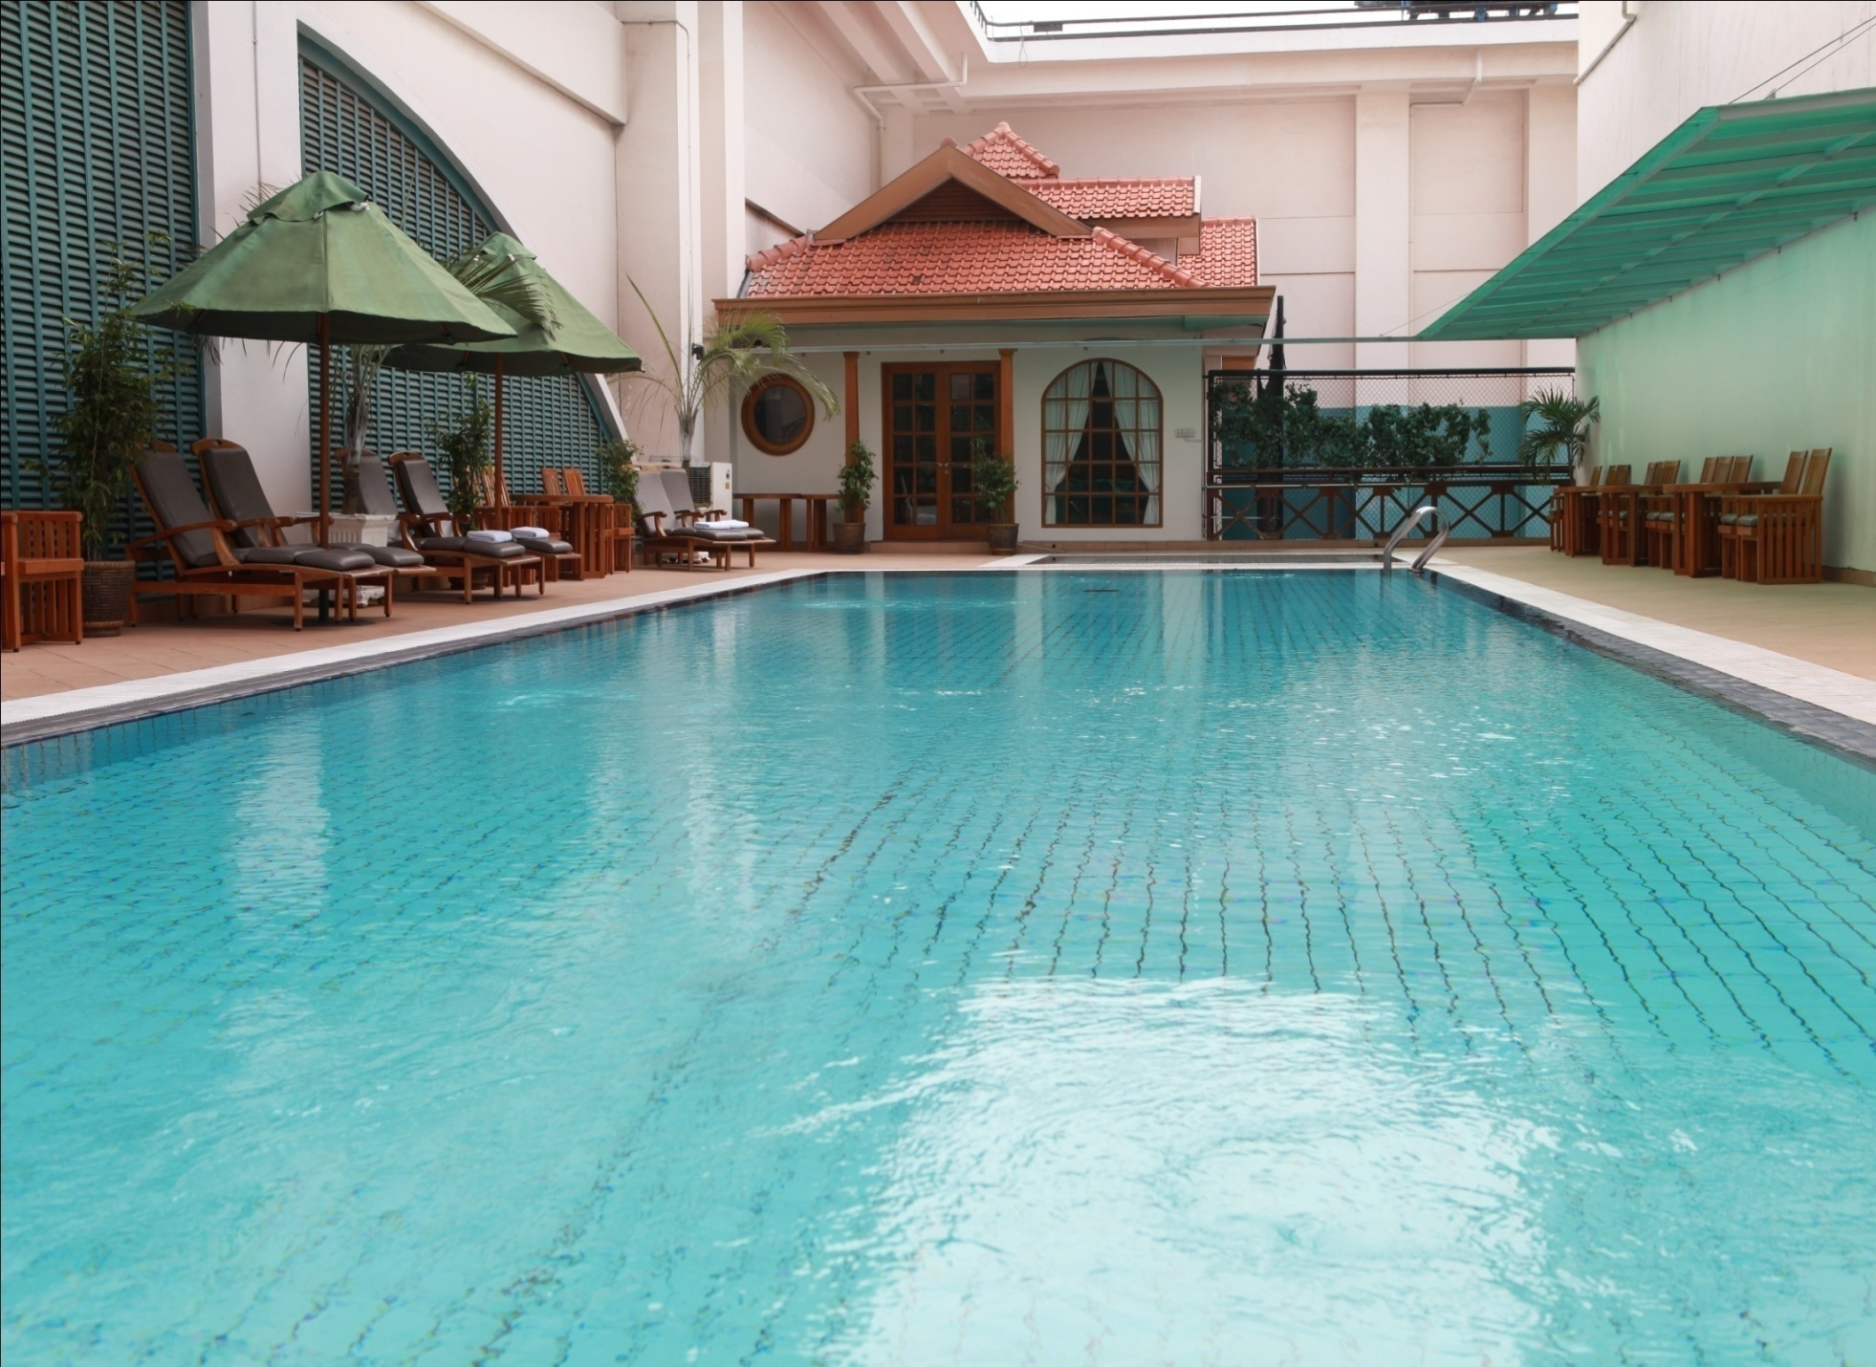
Swimming Pool

Slide 24
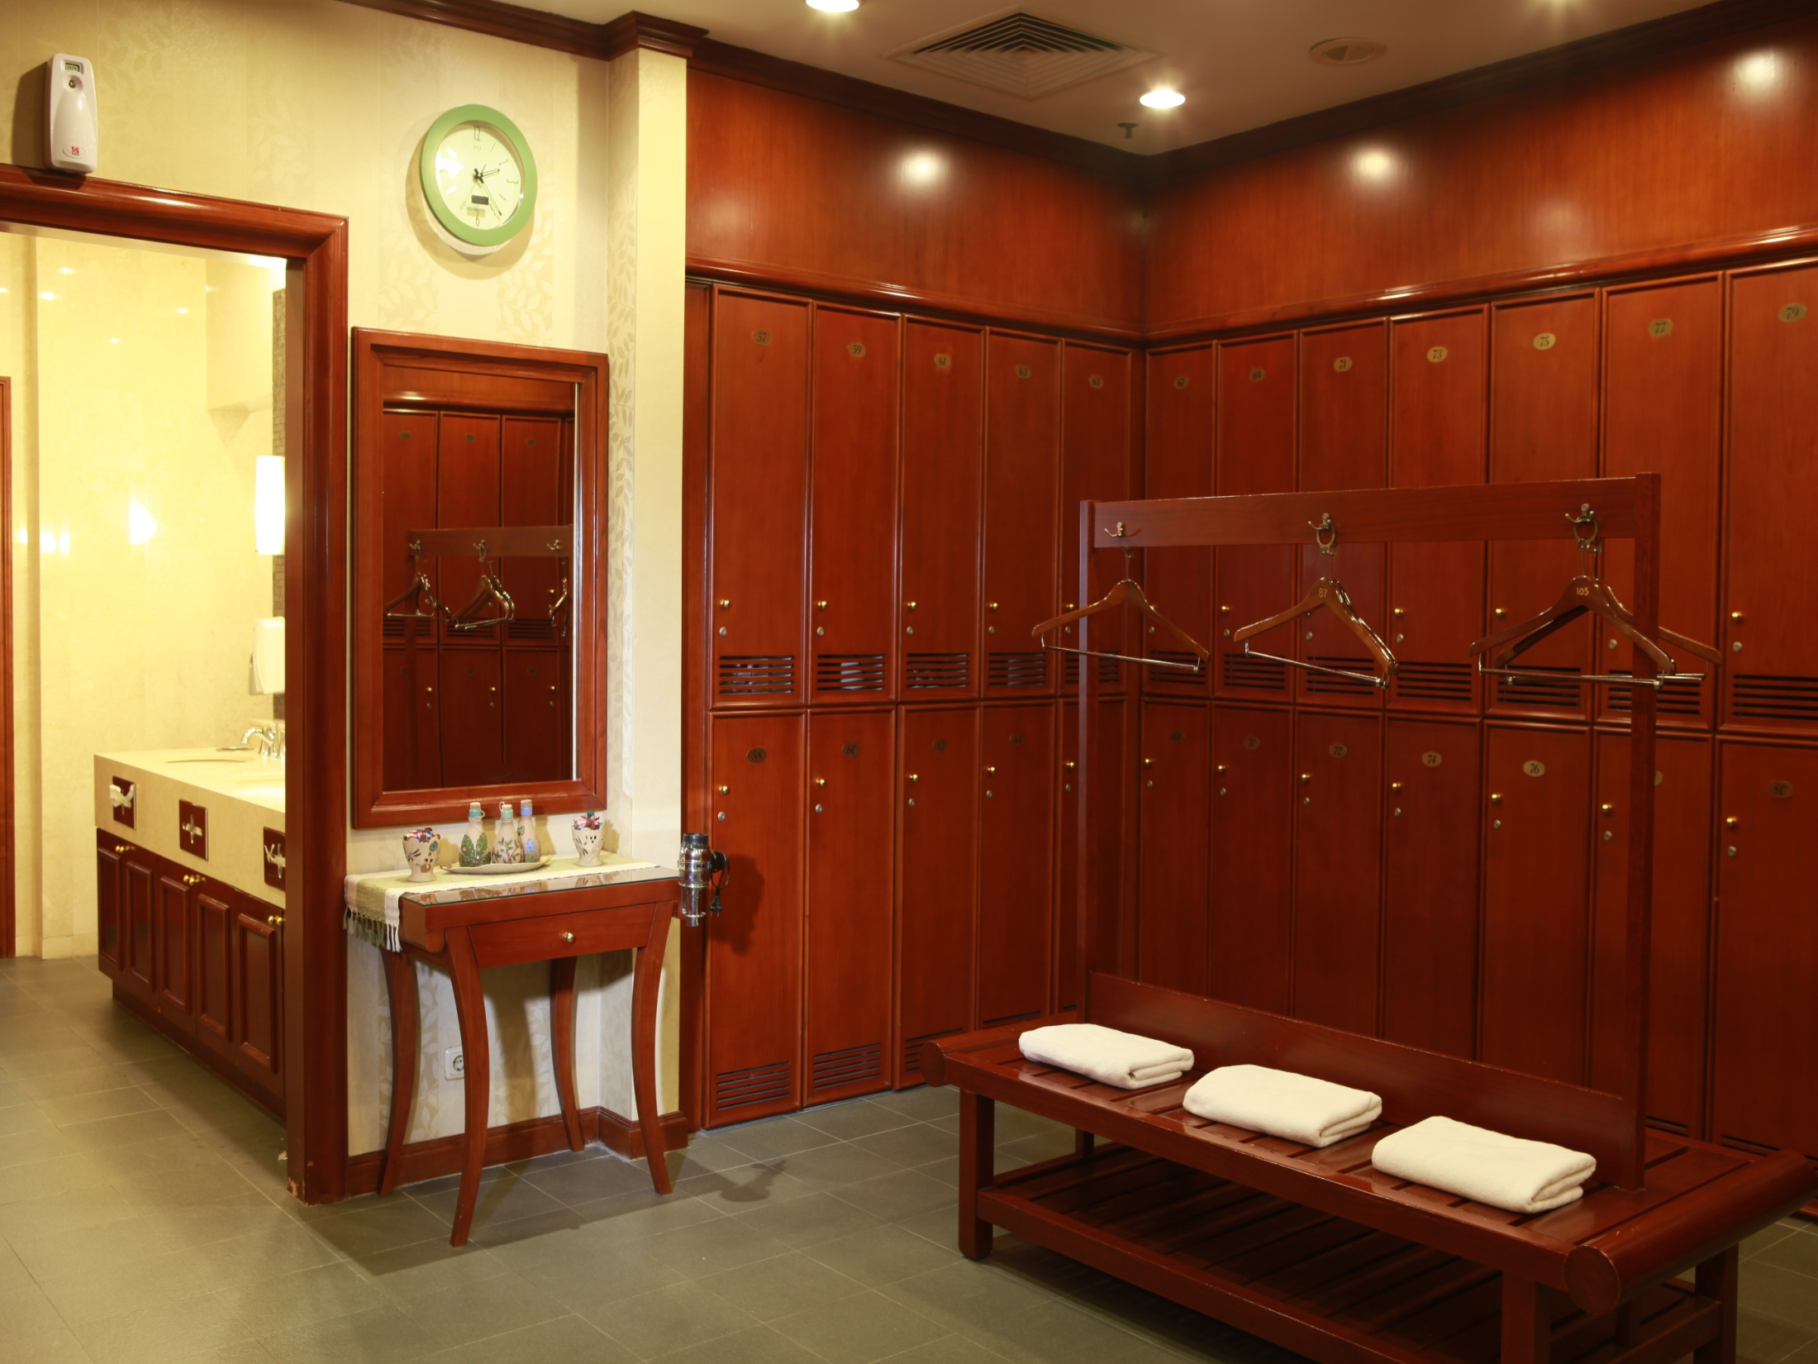
Members Locker

Slide 25
MAC Upcoming Events

Slide 26
MEMBER’S GATHERING Tuesday, March 21, 2017

Slide 27
SPORTS & RECREATION

Slide 28
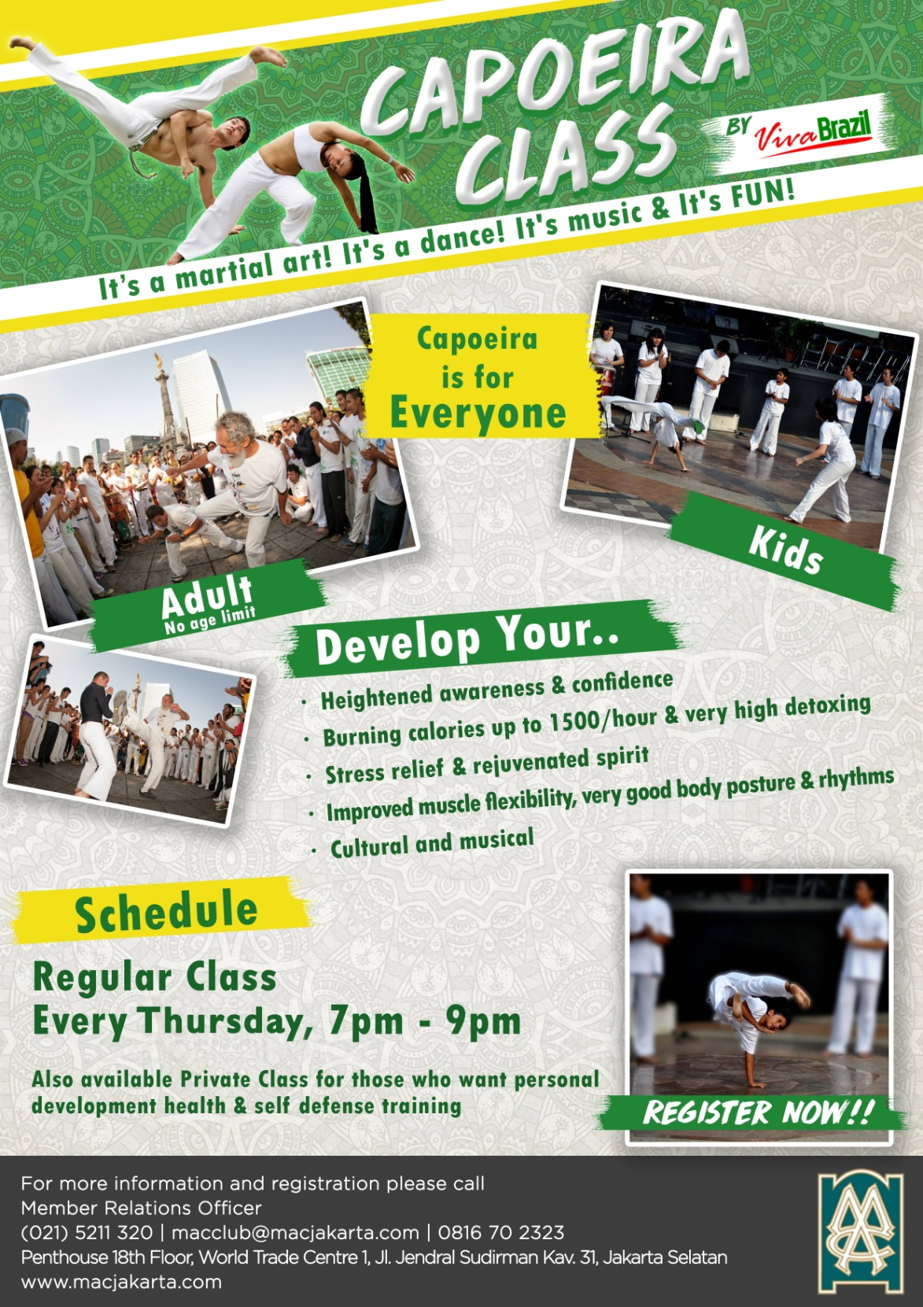

Slide 29
F&B PROMOTIONS

Slide 30



Slide 31
BANQUET PROMOTIONS

Slide 32
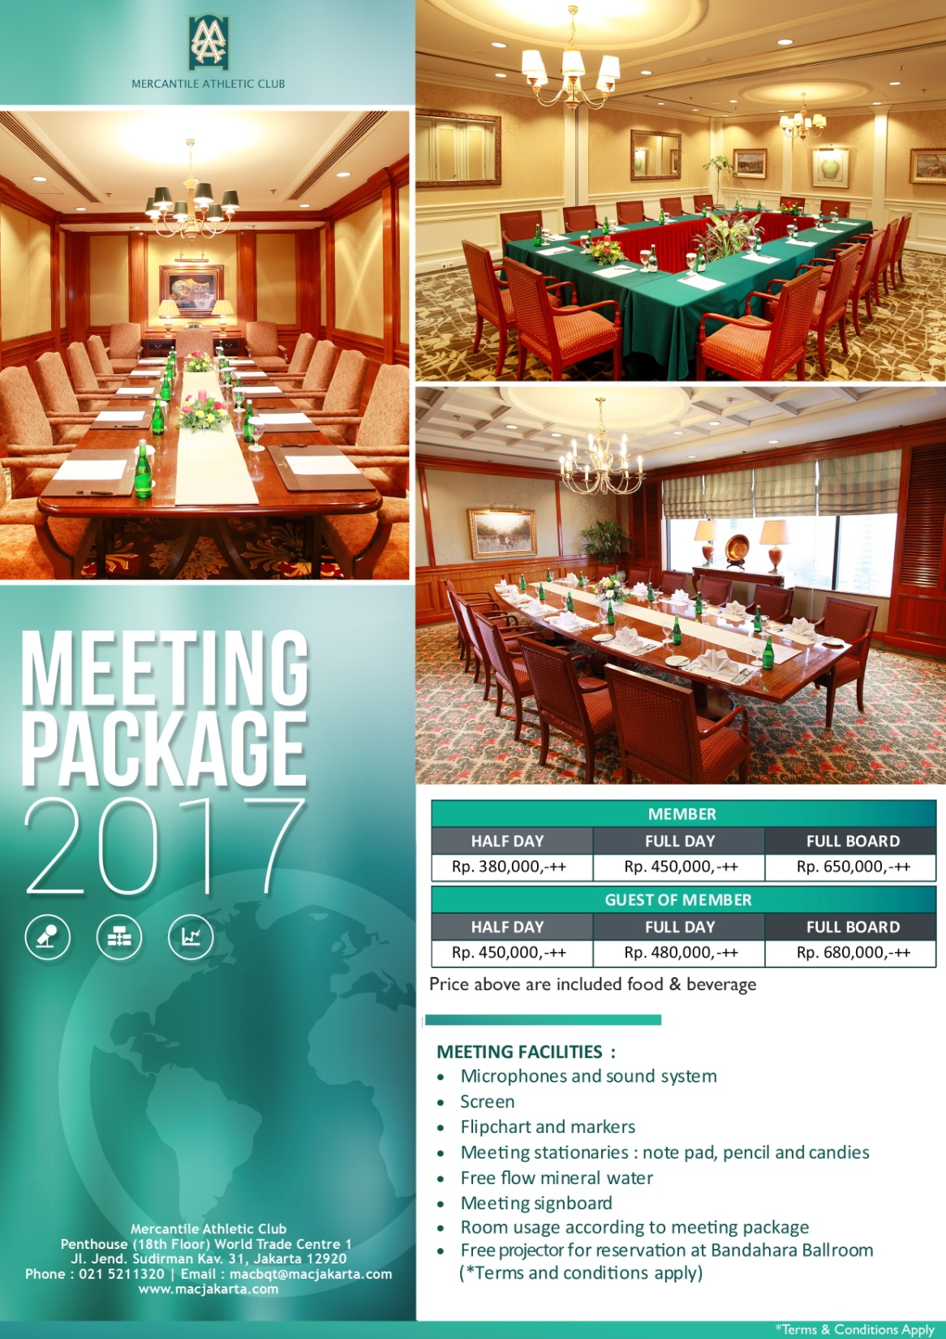

Slide 33
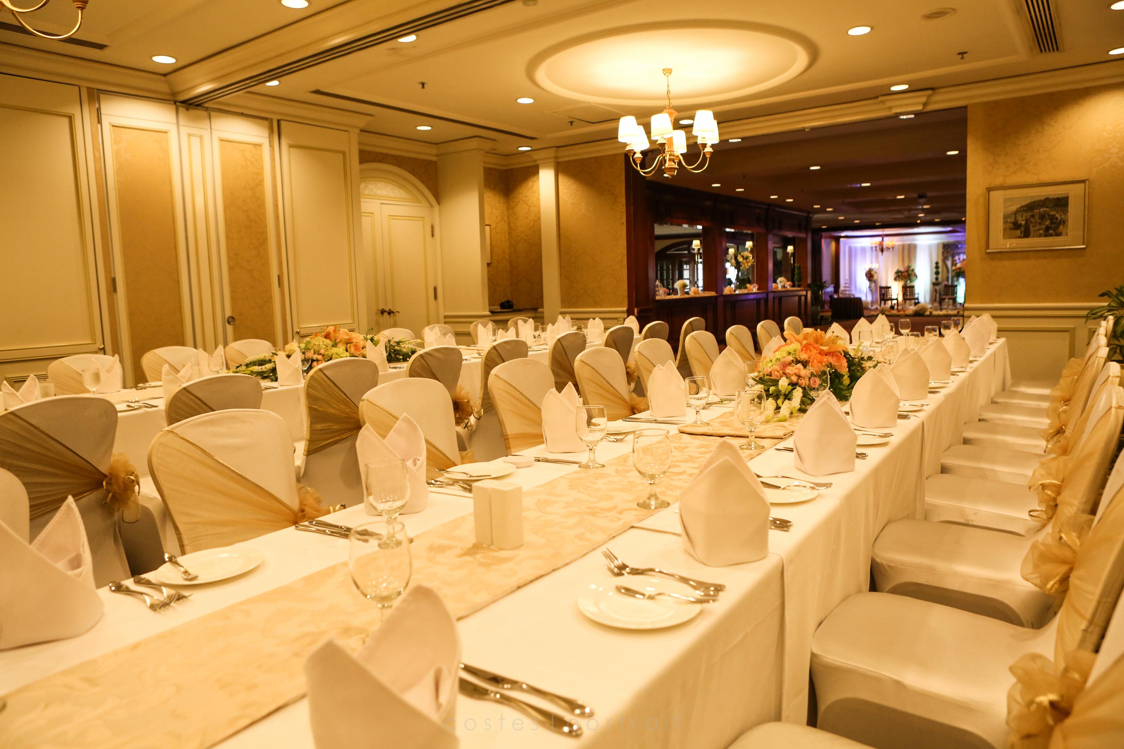
Wedding VIP Room

Slide 34
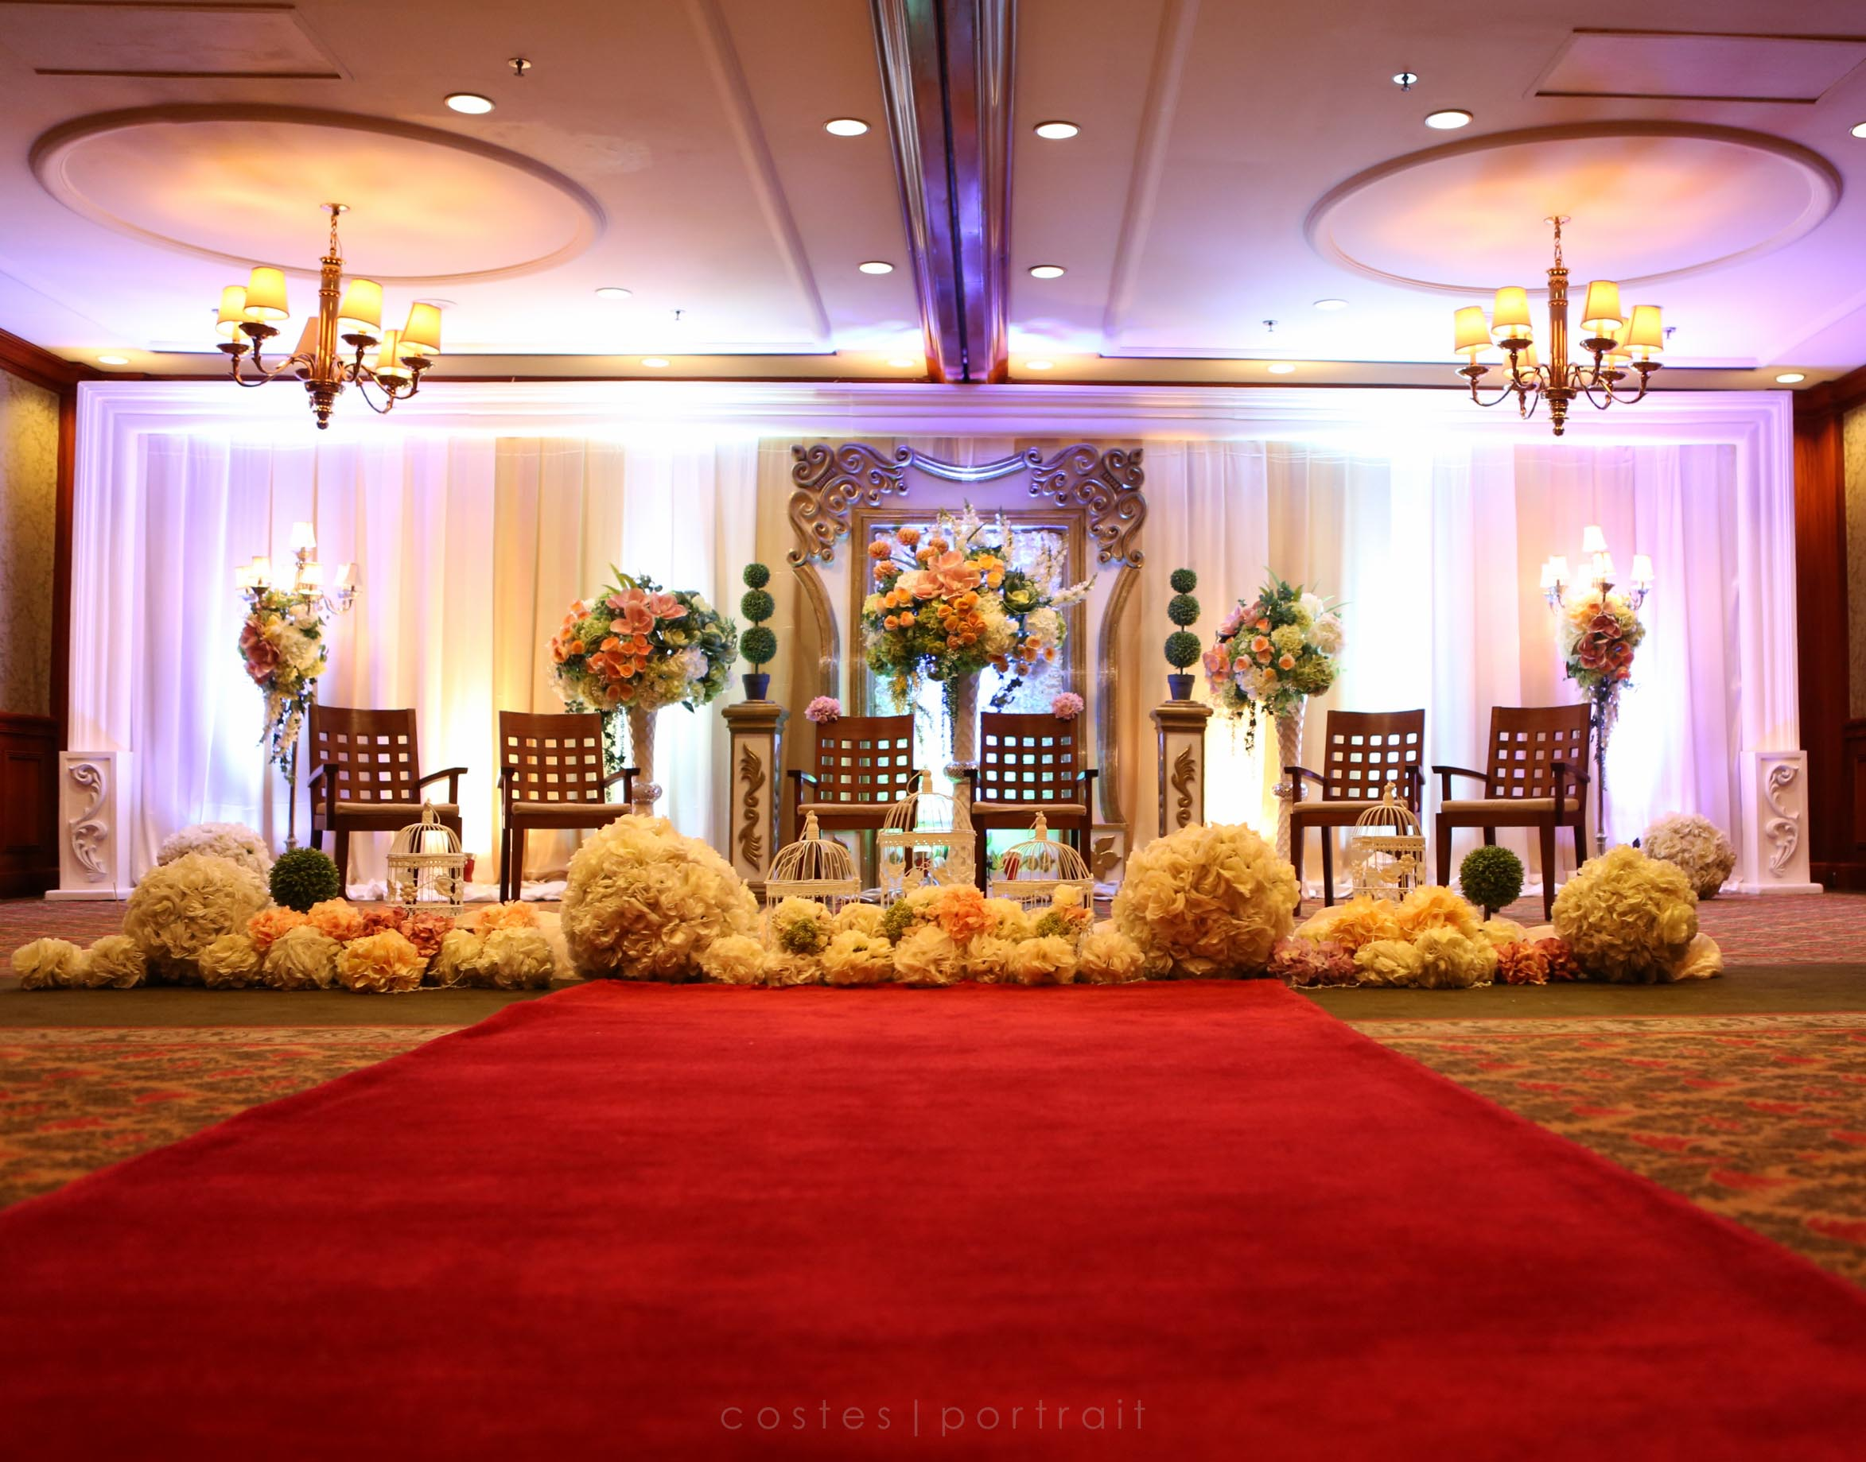
Wedding Stage
Wedding Stage

